Slide 1
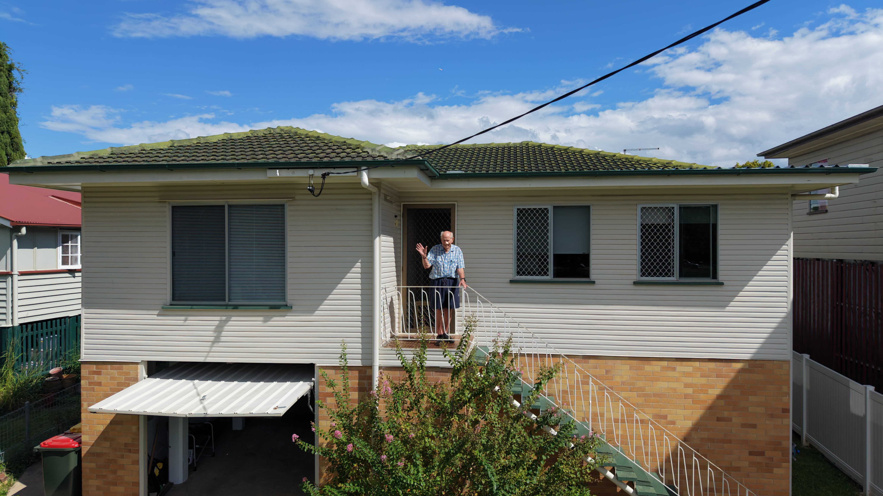
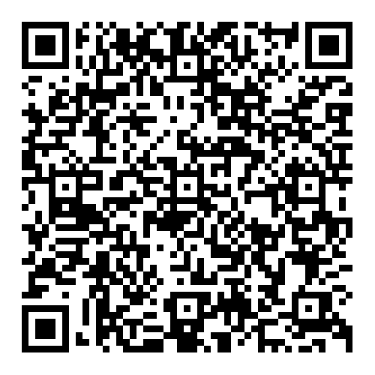

Trial our FREE
Resilience Ratings
Home Assessment
Part of the Household Resilience Ratings Program
Proudly supported by City of Gold Coast
  SCAN HERE TO
  REGISTER NOW

Slide 2



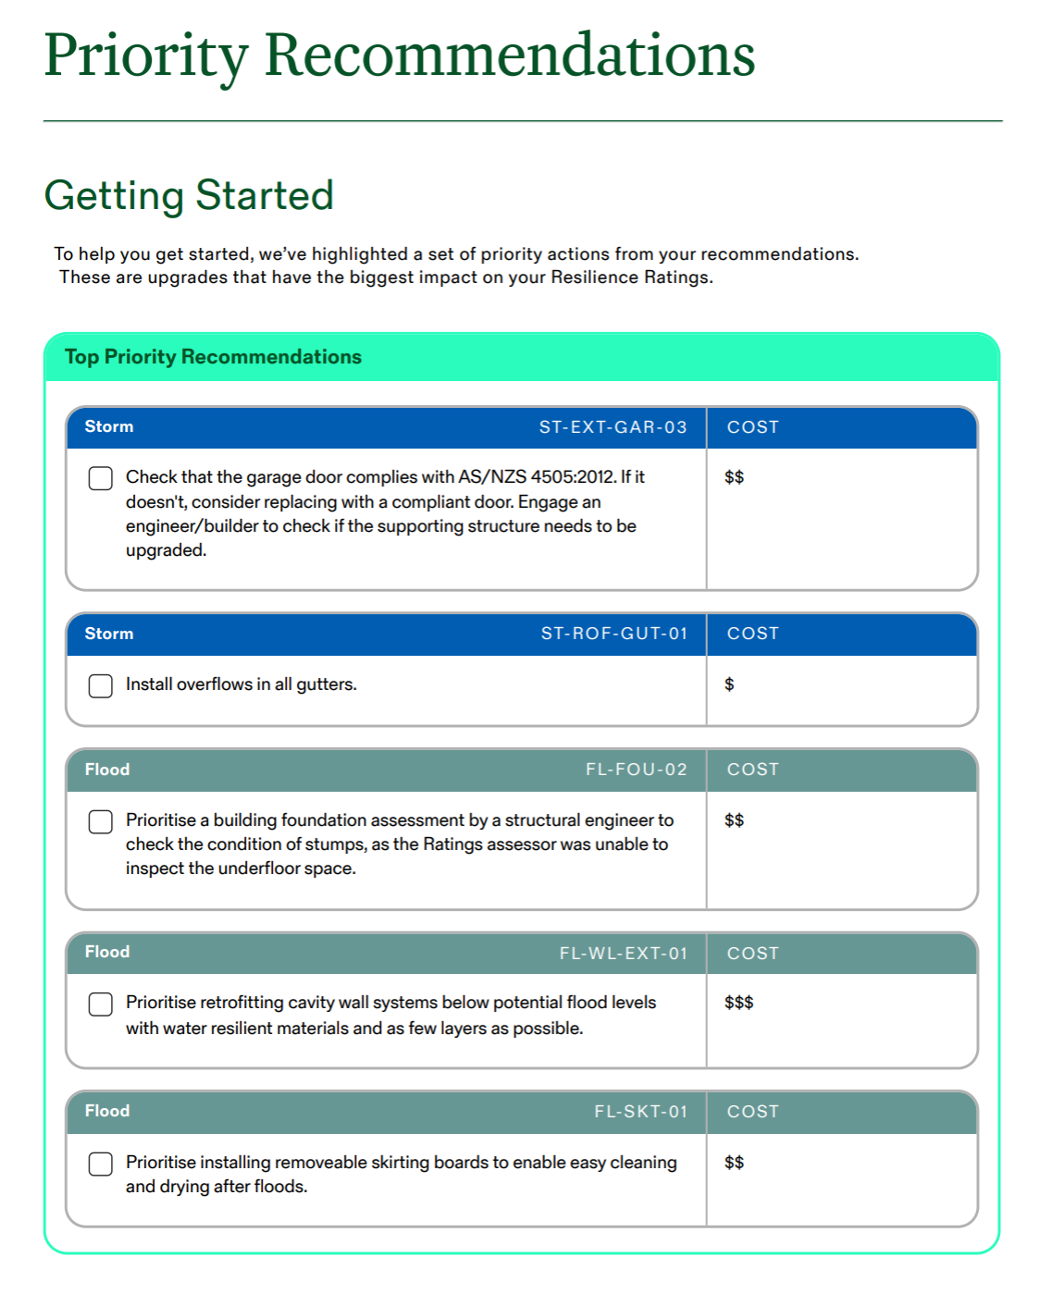
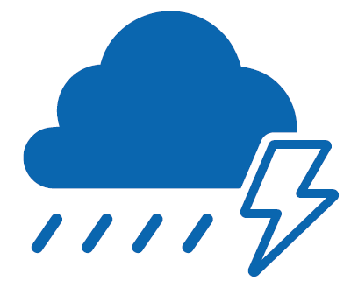
Program Overview
The City of Gold Coast is offering 1000 free Resilience Ratings Home Assessments to freestanding homes.
Understand how your home will perform during:
Floods
Bushfires
Severe storms
Tropical cyclones
Receive a personalised Action Plan with practical
steps to strengthen your home.

Slide 3
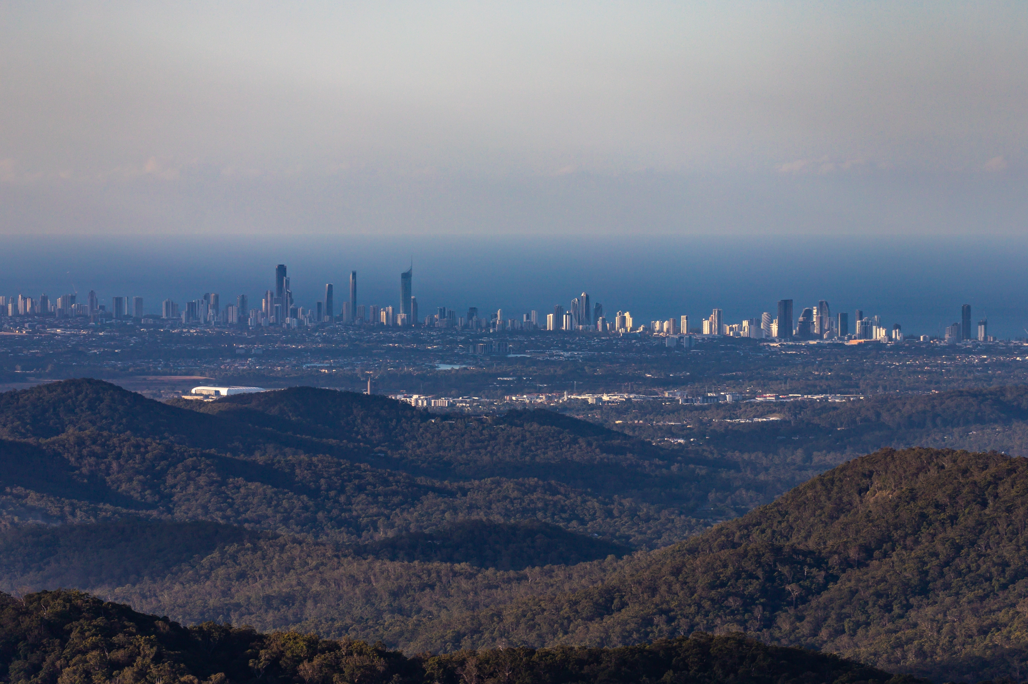
Why the Gold Coast?
First community in Australia to lead a national trial of the multi-hazard Resilience Ratings Home Assessment at scale
The Gold Coast has experienced significant impacts from floods, severe storms, tropical cyclones and bushfires
This project will help households better prepare for future events
Your participation helps improve community-led Resilience Ratings tools, supporting safer, insurable homes

Slide 4
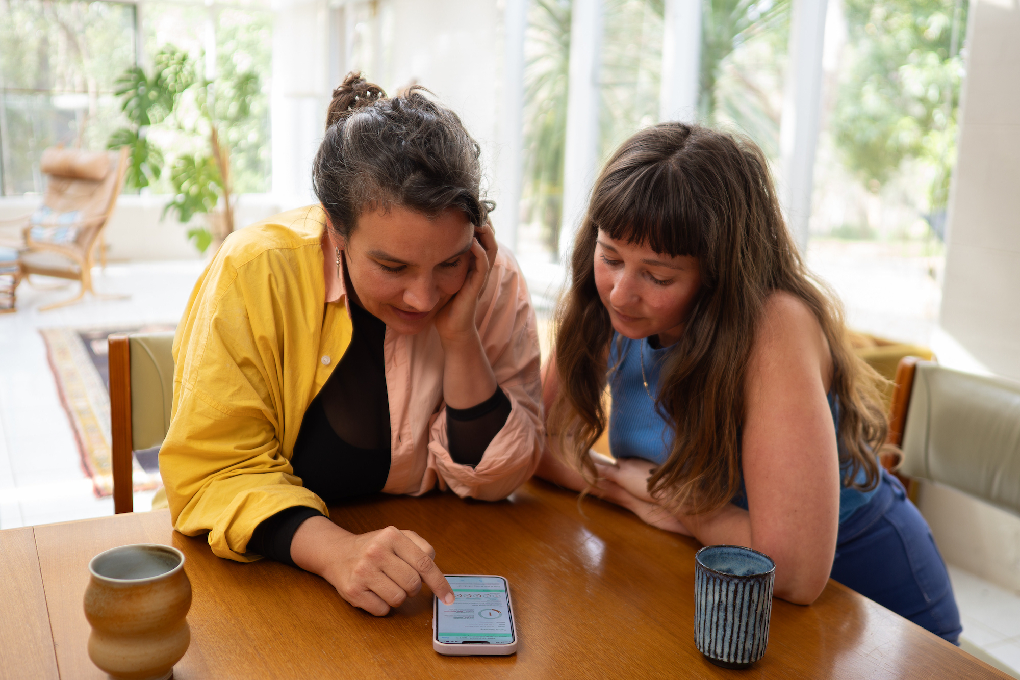
The Assessment Process
Takes 45 minutes to complete and can be completed over multiple sessions
For everyday homeowners and does not require any building, engineering or technical expertise
Requires a smartphone, tablet or computer to take and upload photos
Designed so households can complete it safely themselves
For more information and to sign up scan the QR or visit rbcouncil.org/gold-coast
  Scan here to register

Slide 5
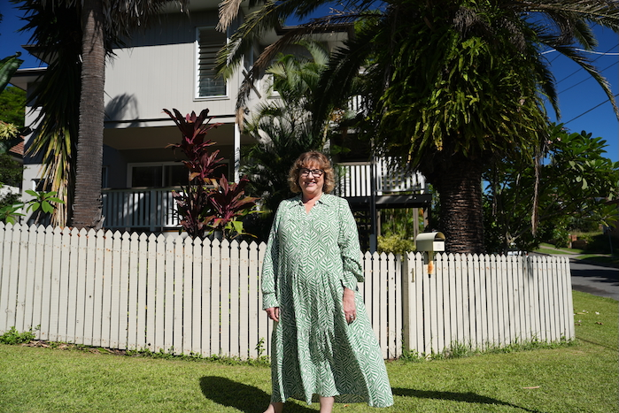
Key Details
Open until September 30th 2026
Capped at 1000 participants, invited by registration date
Households who complete their assessment will go into our Mitre 10 voucher $2000 prize draw. Additional entries for:
  Completing it in 14 days
  Referring a household that completes an assessment
Your personal information, assessment data or Resilience Ratings will not be shared unless you give express permission. Any case study data is de-identified and securely handled.
  Scan here to register
rbcouncil.org/gold-coast

